Slide 1

Earthquake prediction models based on Catboost and SVM with Python-based seismic data analysis
Supervisor: Yang Lei
Student: Mao Zunjie

Slide 2
1
Background
Current Situation, Relevant work in recent years
2
Data Description
Data Source and basic description
CONTENTS
3
Data Visualization and Analysis for 2021 earthquakes
4
Earthquake prediction Models
The Catboost and SVM prediction models based on acoustic data
5
Results
Score for models and a brief conclusion

Slide 3
01
Background

Slide 4
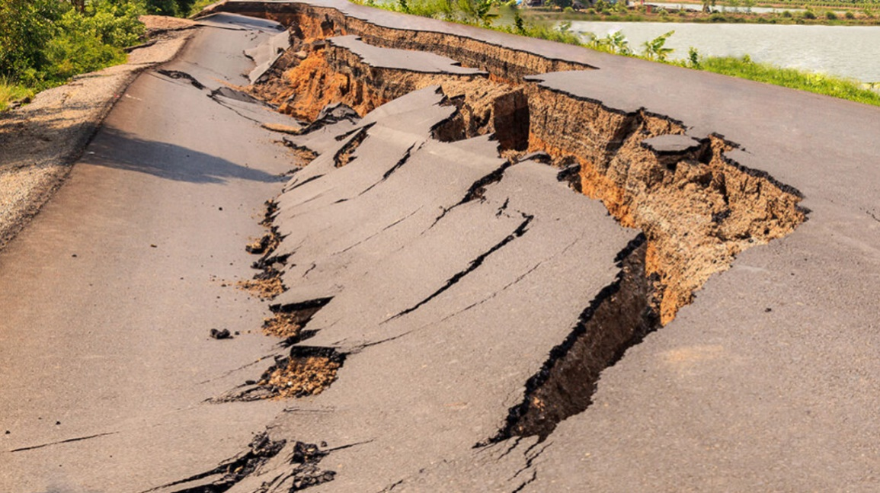
1.1 Background
Earthquakes, as a natural phenomenon, occur frequently on our planet. We first explore the impact of earthquake plates, the connection between magnitude and depth from the perspective of data analysis and visualization.

Slide 5
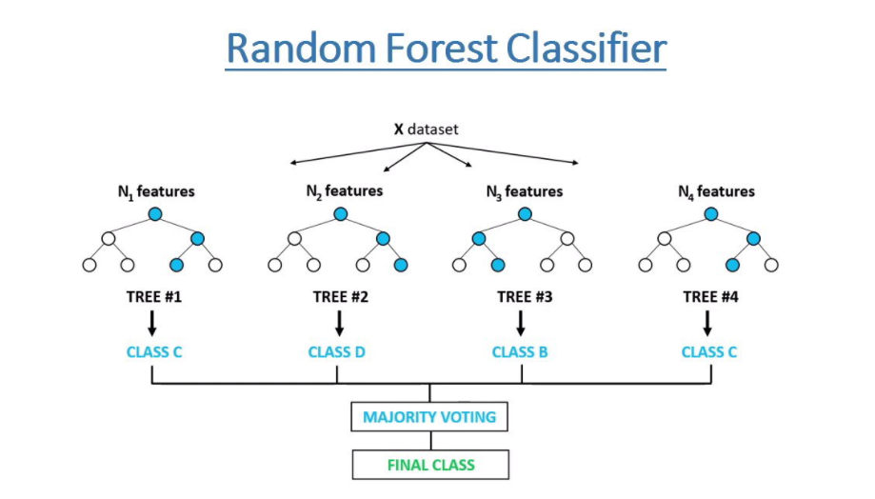
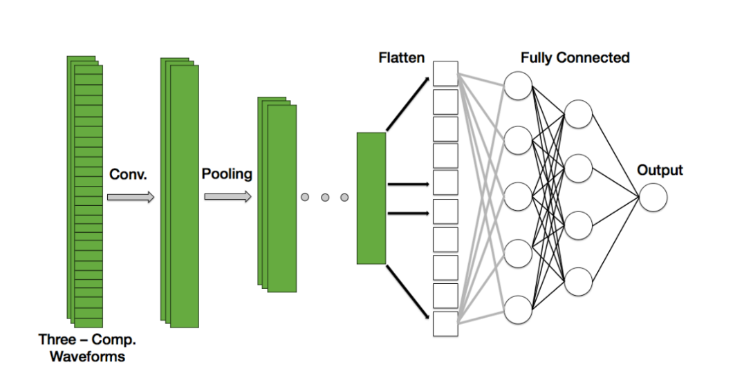
Literature Review – Earthquake Prediction
Breakthroughs in recent years
Random Forest (2018)
Convolutional Neural Network (2018)
Satellite with ground system (2022)
Notes:
We selected some samples from the training data and randomly selected some features for training, each tree sample features are different, the training results are more different, tree voting to get the final results. CNN is a local-to-whole, detail-to-macro learning process. The input layer is used for data input and the convolutional layer uses convolutional kernels for feature extraction and feature mapping. pool sparsely processes the feature map.

Slide 6
02
Data Description

Slide 7
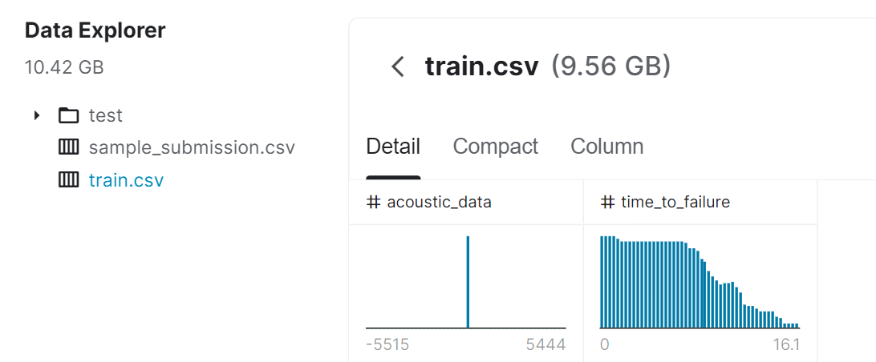
2.1 Data Source
1. Crawling Data from China Earthquake Network Center( news.ceic.ac.cn)
2. Data provided by Los Alamos National Laboratory, USA in Kaggle

Slide 8
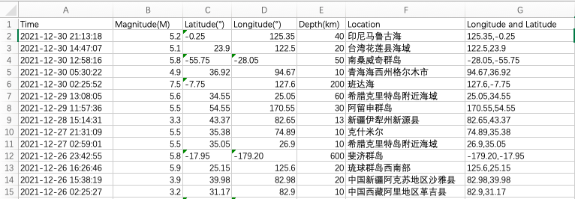
2.2 Data Description
Annual earthquake data for 2021 (crawled from China Earthquake Network Center)

Slide 9
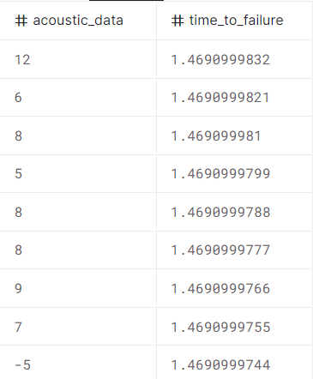
2.2 Data Description
train.csv - A single, continuous training segment of the experimental data. (contains 629145480 lines of data)
test - A folder containing many small segments of test data. (242MB, 2624 files, each containing approximately 150,000 segments of data.)
Data Fields:
acoustic_data - The seismic signal [int16].
time_to_failure - Time in seconds until the next lab earthquake [float64]
seg_id - ID of the test segment that should be predicted (one prediction per segment).

Slide 10
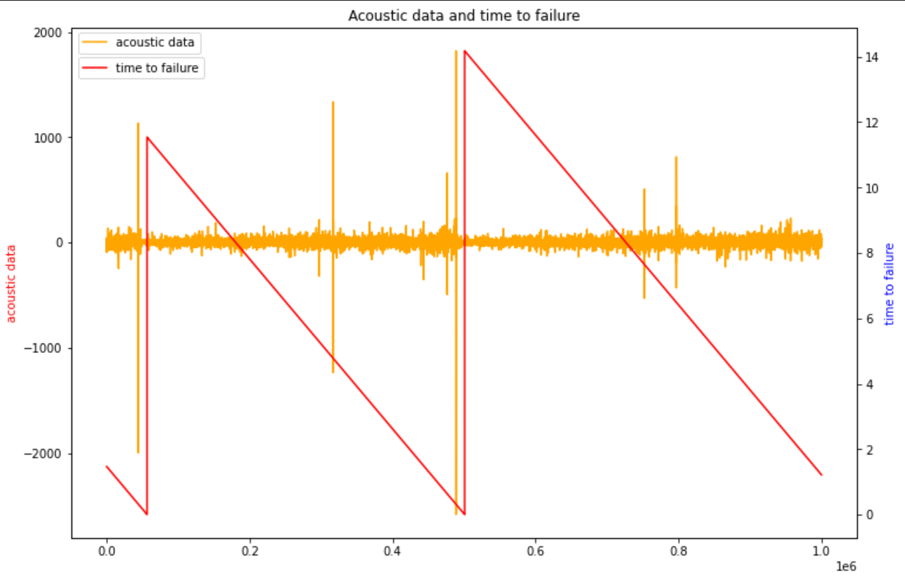
Acoustic Data Wave

Slide 11
03
Data Visualization and Analysis for 2021 earthquakes

Slide 12



3.1 Data Visualization
Map Lab - To visualize the distribution of earthquakes in Asia and China throughout 2021 based on the timeline.
Tableau - Visualization of the relationship between magnitude and depth throughout 2021
Jupyter Notebook + Python - Histogram of the joint distribution of magnitude and depth throughout 2021

Slide 13
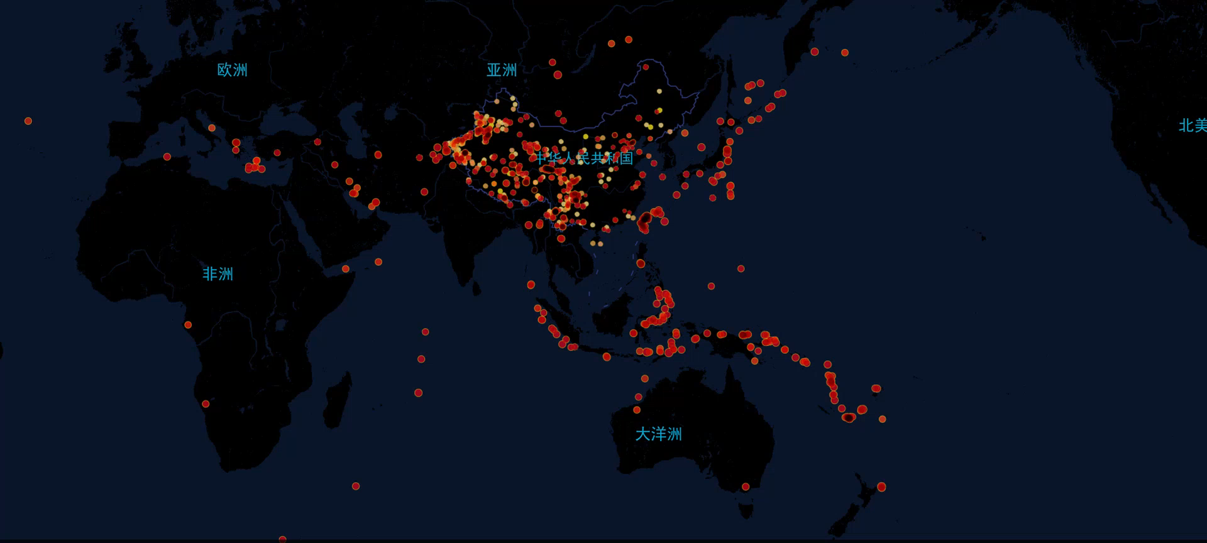
Visualization based on Map Lab

Slide 14
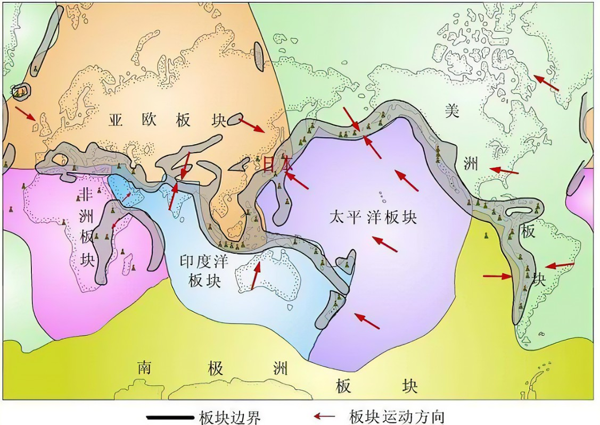
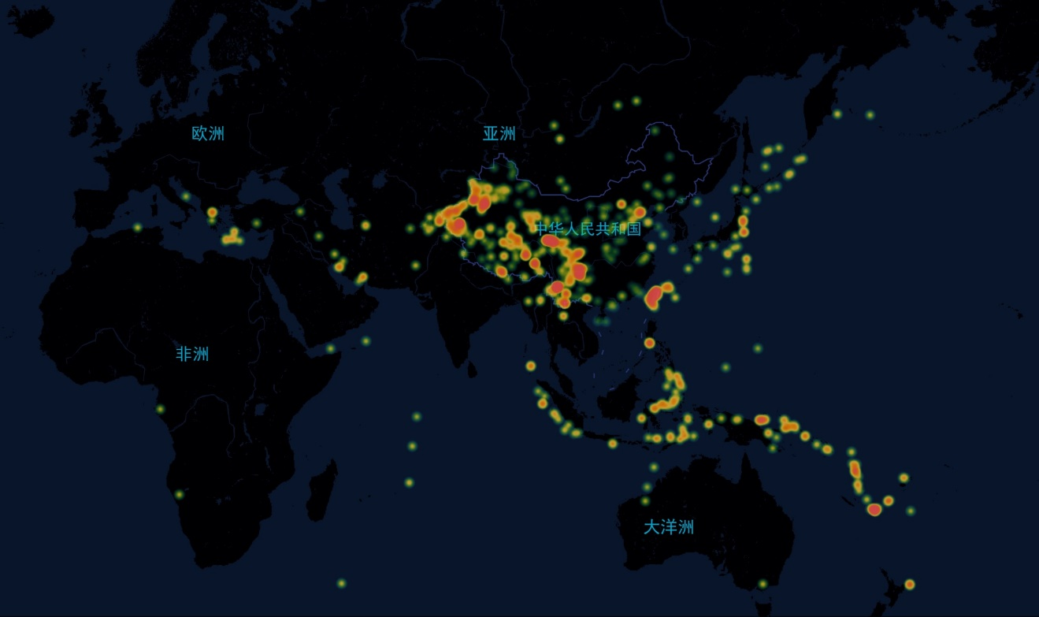
Theory and Actual Earthquake Distribution
Earth plate distribution Heat Map

Slide 15
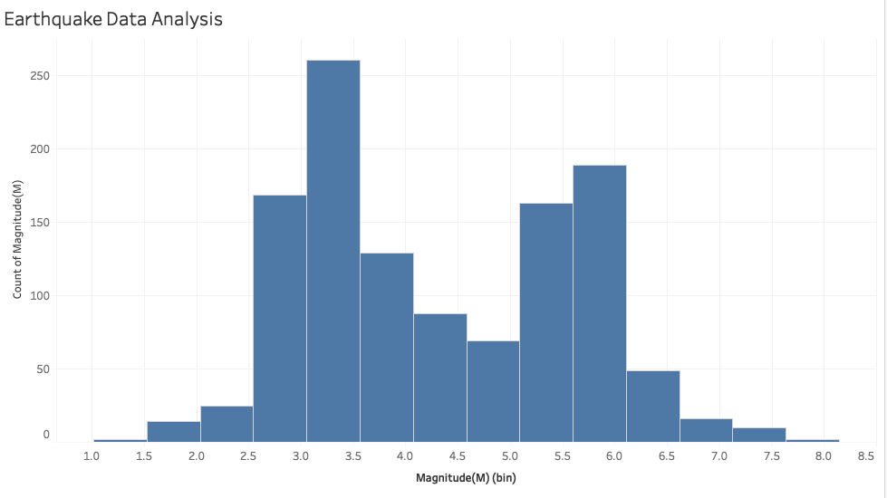
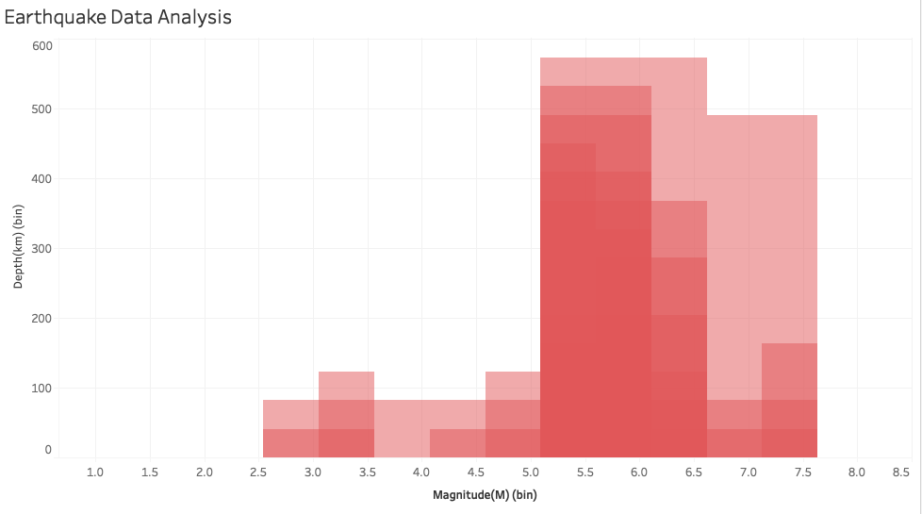
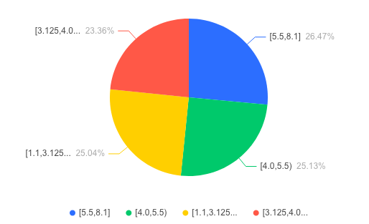
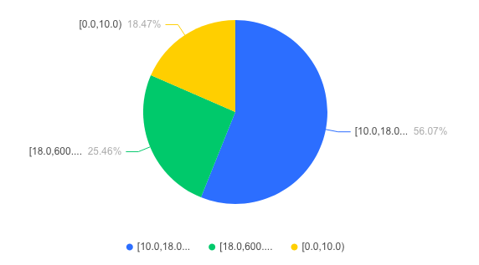
3.2 Visualization of Magnitude and Depth

Slide 16
2021 Earthquakes Conclusion
1. earthquakes of magnitude 2-6 are frequent.
2. those with depths over 200 km are concentrated only in magnitude 5 or higher.
3. earthquakes with depths up to 600km are mostly concentrated in magnitude 5-6.
4. The depth of the source of earthquakes below magnitude 5 generally does not exceed 150km.
5. The most frequent earthquakes occurring throughout the year are near magnitude 3.0.
6. There is no obvious linear relationship between the two, but there is a mutual influence.

Slide 17
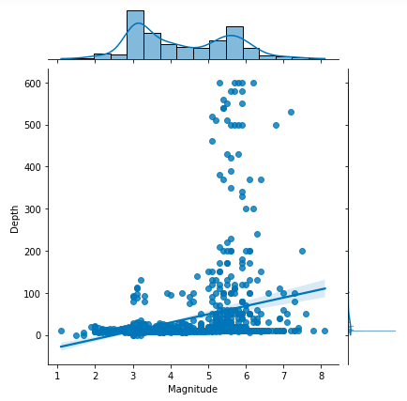
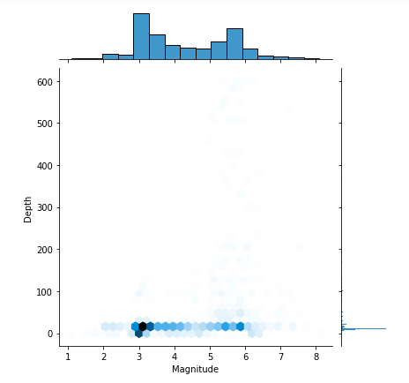
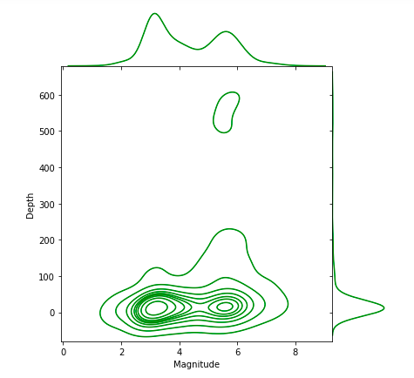
3.3 Python Visualization
Scatter plot Hex plot Kdeplot

Slide 18
3.4 Main part of 2021 Earthquakes Data Analysis
 | Magnitude(M) | Latitude | Longitude | Depth(km)
count | 1186 | 1186 | 1186 | 1186
mean | 4.308263 | 21.990658 | 75.578938 | 35.363406
std | 1.271299 | 24.354753 | 80.377949 | 86.572057
min | 1.1 | -61.7 | -179.74 | 0
max | 8.1 | 63.2 | 179.71 | 600
Var | 1.6148 | \ | \ | 7488.4
median | 4 | \ | \ | 10

Slide 19
04
Earthquake Prediction Models

Slide 20
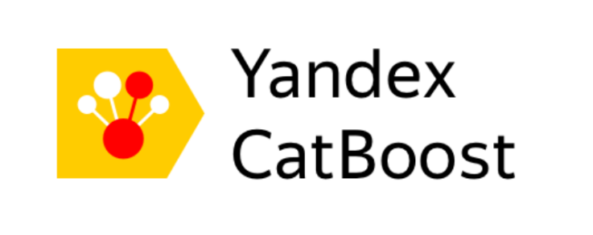

4.1 Model based on Catboost
Data processing
Define Model ( Regression or Classification)
Train model, find best fit
Result
Platform: Google

Slide 21
Why Catboost?
Use CatBoost without any explicit preprocessing to convert categories to numbers.
Born in 2017, It can compete with any leading machine learning algorithm in terms of performance.
Easy to use: We can use CatBoost from the command line

Slide 22
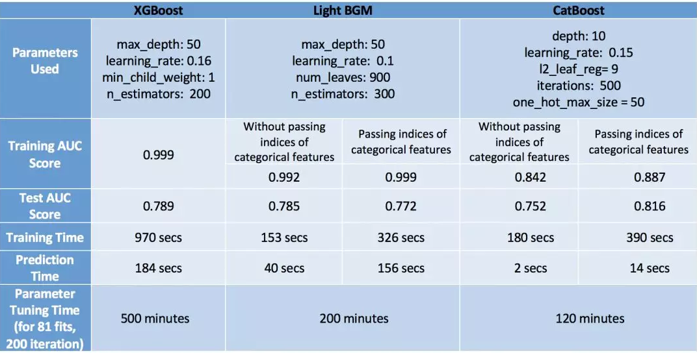
Comparison with other Mainstream Algorithms

Slide 23
How Catboost Works
Given a training set S, there are n instances in S
Randomly permutate rows of S to generate new training sets. We do the permutation process s times to generate s new different training set Sr(r=1,2...s).
Initialize Matrix M(r, i), represents the prediction value for instance i on training set Sr.
Randomly choose one permutation training set Sr, Apply Ordered Target Statistics (TS) , build a new tree T, Using the new tree T to predict all permutation dataset S1,S2...Ss and update M (each set). Repeat the Step 3 for I times to build I trees.
Based on the output I trees, we can get any instance prediction by average all I tree’s predictions on the instance.

Slide 24
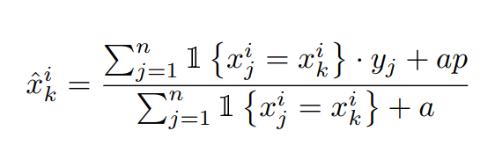
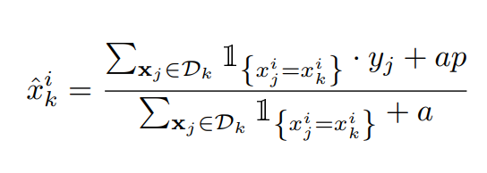
How Catboost Works
Target Statics
The target variable statistics are used to estimate the expected value of the target variable for each category.
The target mean encoding formula
Order TS
the data set is first generated in random order and then TS is calculated using the observable history.
Notes:
For example, seg ID, this encoding method generates a large number of new features and causes dimensional disasters. A frequently used approach is to group features according to Target Statistics, which is used to estimate the expected value of target variables for each category. mean encoding is a way of encoding category features. 期望，简单理解为均值即可。

Slide 25
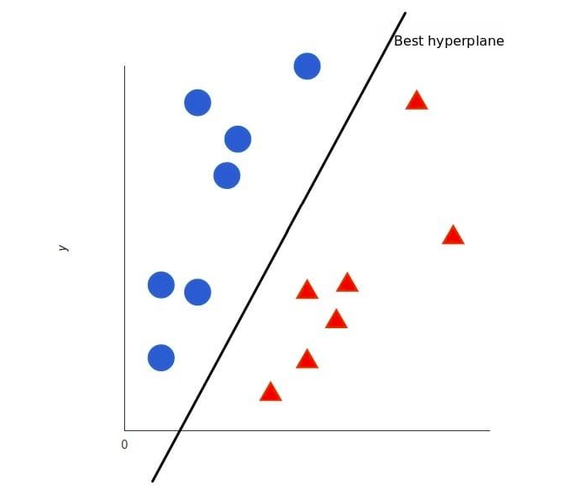
4.2 Model based on Support Vector Machine
Support vector machine (SVM) is a type of binary classification model.
The optimal hyperplane for feature space partitioning is the goal of SVM, and the idea of maximizing classification margins is the core of the SVM method.

Slide 26
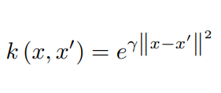
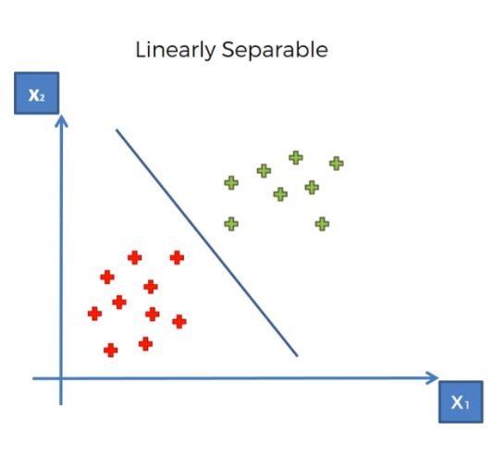
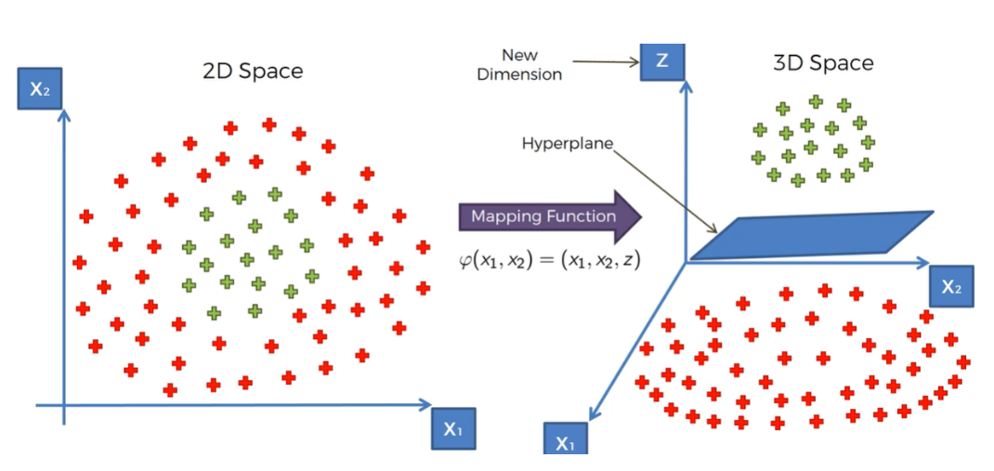
4.2 The Gaussian RBF Kernel function
The Kernel Trick helps us to actually visualize the non-linear datasets which are more complex and cant be solved or classified on the basis of a linear line.
Gaussian kernel function:

Slide 27
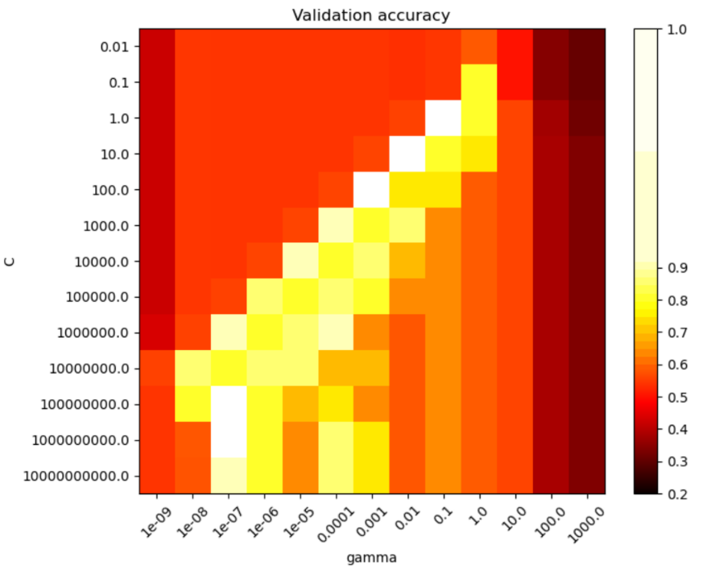
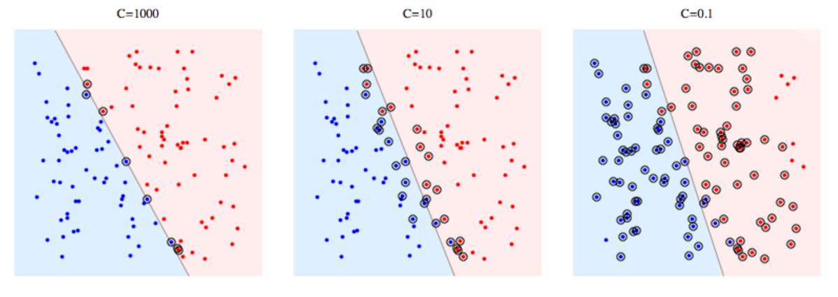
4.2 Gamma and C
C- It is a hypermeter in SVM to control error.
Gamma- it is used when we use the Gaussian RBF kernel.
Larger in C indicates less tolerance for error and possible overfitting, the smaller the c, the greater the error tolerance.
The larger the gamma value, the better the training result, but the more likely to cause overfitting and low generalization ability.

Slide 28
4.2 Data Processing
StandardScaler() standardizes the data, ensuring that the variance of each dimension is 1. The mean value is 0.
GridsearchCV: Grid search, which searches for parameters, means finding the parameter with the highest precision on the validation set from all parameters in the specified parameter range.

Slide 29
05
Results

Slide 30


5.1 Result
Catboost
SVM
 | Catboost | SVM
Score | 0.0029 | 0.003
Note: In sklearn, all losses are represented as negative numbers, so either the mean squared error or the squared error will be calculated as negative numbers.

Slide 31

Q & A
Thanks for Listening
Supervisor: Yang Lei
Student: Mao Zunjie

